Slide 1
EMPLOYEE ATTRITION ANALYSIS

Slide 2
INTRODUCTION
Welcome to my Employee Attrition Analysis report
In this document, we'll explore why employees leave their jobs and how it impacts businesses. Employee attrition, or turnover, is when employees leave their jobs voluntarily or involuntarily. Understanding why employees leave can help businesses improve retention strategies and maintain a happy and productive workforce. By analyzing factors such as job satisfaction, compensation, and work-life balance, we aim to provide insights that can help organizations reduce attrition rates and retain valuable talent. Let's delve into the fascinating world of employee attrition analysis!

Slide 3
PROBLEM STATEMENT
XYZ company which was established a few years back is facing around a 15% attrition rate for a couple of years. And it's majorly affecting the company in many aspects. In order to understand why employees are leaving the company and reduce the attrition rate XYZ company has approached an HR analytics consultancy for analyzing the data they have. You are playing the HR analyst role in this project and building a dashboard which can help the organization in making data-driven decisions.

Slide 4
HOW I STARTED THIS PROJECT?
1. Collect Data: I gathered data about my employees, including information like employee demographics, job roles, performance ratings, salary details, and whether they have left the company (attrition status).
2. Open Power BI Desktop: Launched Power BI Desktop on my computer.
3. Connect to Data: I clicked on "Get Data" and selected my data source (e.g., Excel file, CSV, or database) where my employee data is stored. Imported my employee data into Power BI.
4. Transform Data: Used Power BI's data transformation tools to clean and prepare my employee data. This may involve removing duplicates, renaming columns, or formatting data types.
5. Create Visualizations: I Designed my dashboard by adding visualizations such as charts, graphs, and tables. For example, you might create a pie chart to show the distribution of employees by department or a bar chart to display attrition rates over time.
6. Analyze Attrition Factors: I Identified factors that contribute to employee attrition, such as job satisfaction, compensation, work-life balance, or career development opportunities. Used visualizations to analyze these factors and their impact on attrition rates.
7. Add Filters: Included filters to allow users to interact with the dashboard.
8. Include Key Metrics: Incorporate key metrics related to employee attrition, such as overall attrition rate, voluntary vs. involuntary turnover, and average tenure.
9. Customize Appearance: I customized the appearance of my dashboard by adjusting colors, fonts, and layouts to make it visually appealing and easy to understand.

Slide 5
KPI
Overall Employees: The total number of employees in the company at a given time.
Attrition: The number of employees who have left the company over a specified period.
Attrition Rate: The percentage of employees who have left the company compared to the total number of employees.
Active Employees: The number of employees currently working in the company.
Average Age: The average age of all employees in the company, calculated by adding up the ages of all employees and dividing by the total number of employees.

Slide 6
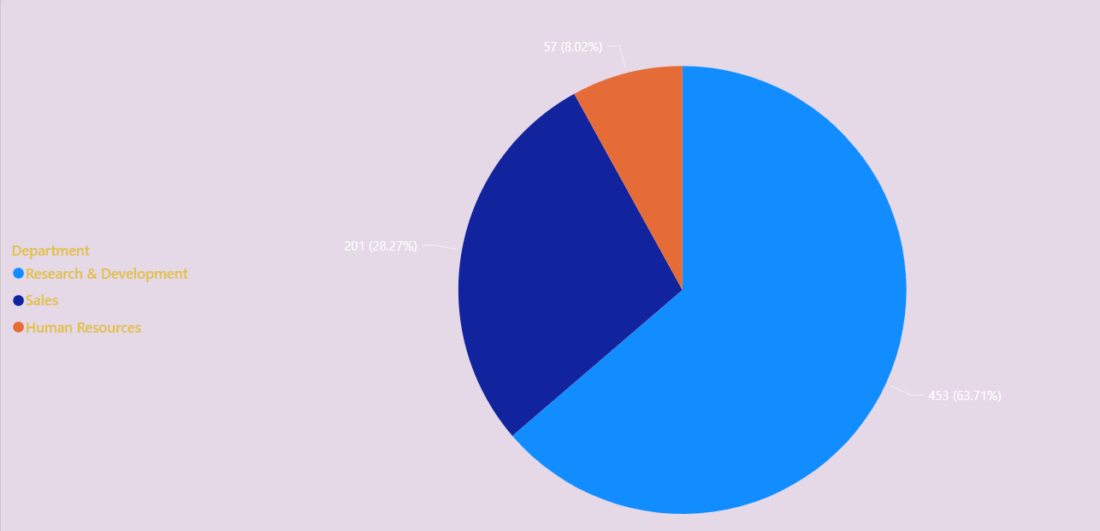
DEPARTMENT WISE ATTRITION

Slide 7
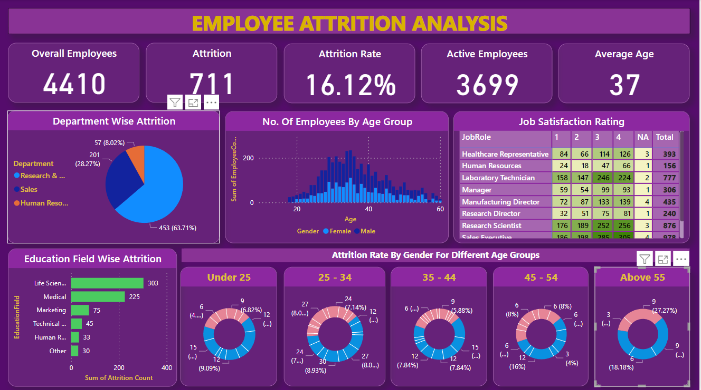
MY EMPLOYEE ATTRITION DASHBOARD

Slide 8
THANK - YOU

